Slide 1
Completing Optional Form 69 for IPA’s
(Non-Federal Employee to VAMHCS)
VAMHCS Human Resources Management Service
04/04/2016

Slide 2
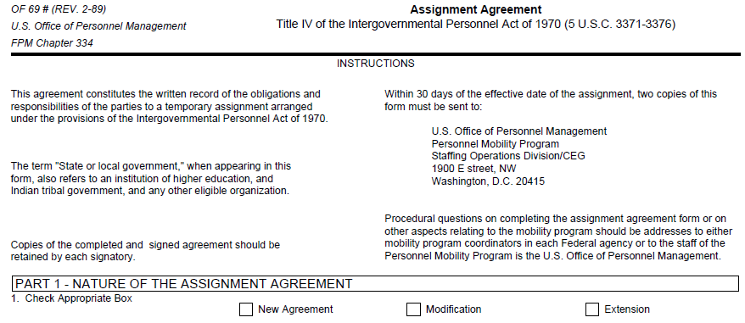
Part 1: Nature of Assignment
New employee, new project, return from break in service
Increase or decrease funding/effort, change in work/project, termination
Extend length of agreement (not to exceed 4 years)

Slide 3
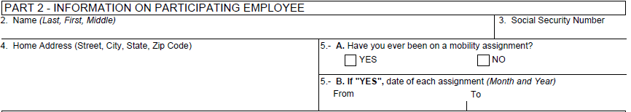
Part 2: Information on Employee
Enter FULL Name. If no Middle Name enter (NMN)
Enter SSN – Minimum accepted is Last Four
Enter complete home address
5A – If on an IPA before (even with another service), must check yes. Otherwise, check no.
5B – Enter ALL dates of previous IPA’s (use separate page if necessary). Otherwise, leave blank.

Slide 4
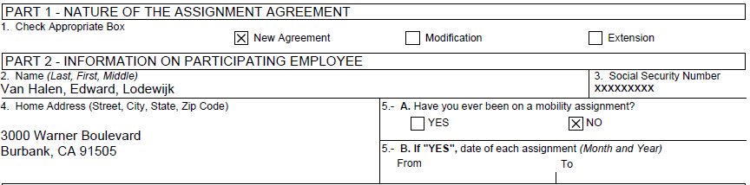
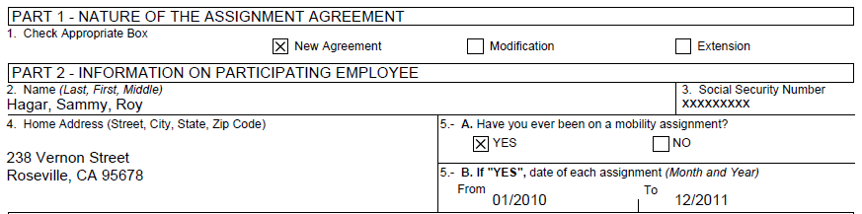
EXAMPLE – NEW AGREEMENT
NEW EMPLOYEE – NO PREVIOUS IPA ON FILE
NEW EMPLOYEE – PREVIOUS IPA ON FILE

Slide 5
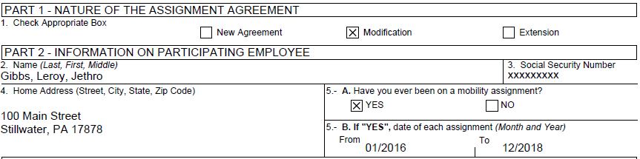
EXAMPLE – MODIFICATIONS (including termination)
All modifications/terminations require an OF69 to be completed. Terminations submitted on any other form are not acceptable (i.e. SF52).
For early terminations – please type (early term) in this area.
Early Term.
Include current IPA dates here, as well as any previous dates. Use separate sheet if necessary.
Notes:
VA Handbook 5005/65, Section 4, Procedures, #5 – Modifications must be recorded and approved just as the original agreement is done. Modifications include significant changes to duties, responsibilities, salary, work location, schedule, or supervisory relationships. Minor changes such as COLA, benefits coverage, or short-term changes do not require a modification.

Slide 6
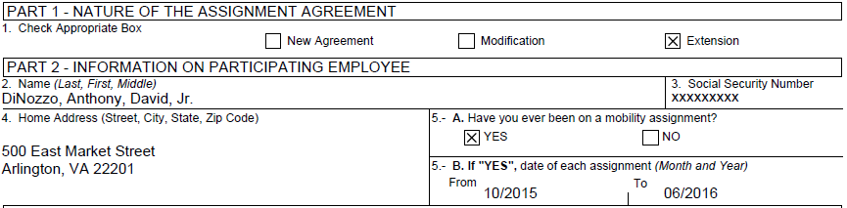
EXAMPLE – EXTENSIONS
Include current IPA dates here, as well as any previous dates. Use separate sheet if necessary.

Slide 7
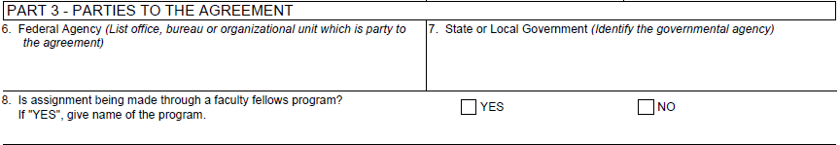
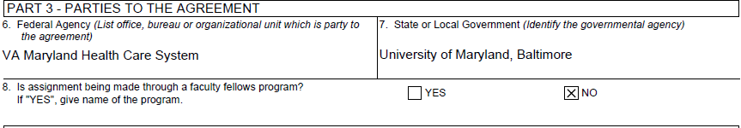
Part 3: Parties to the Agreement
#6 is ALWAYS the Federal Agency.
Enter VA Maryland Health Care System.
Name of University/State/Local Government Agency or NPC (Non-Profit Research & Education Corporation)
This section (#8) should be marked NO. Any questions, call HRMS.
EXAMPLE
Notes:
State/Local Government, Agency, NPC, or Other Organizations must be defined and approved as indicated in 5 CFR 334.102 and 334.103.

Slide 8
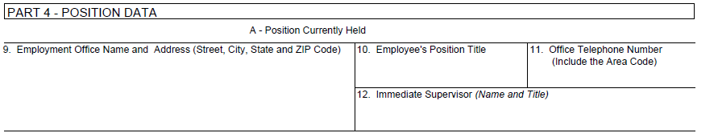
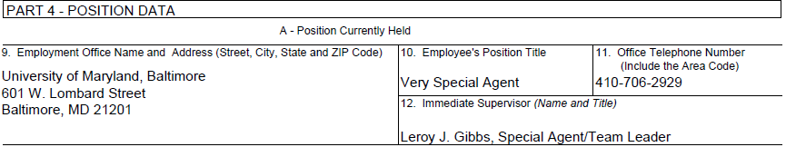
Part 4: Position Data – Position Currently Held
Name and Address of Current Employer – i.e.
University/State/Local Government Agency or NPC (Non-Profit Research & Education Corporation).
Current Employee Title. Examples of Hard-To-Fill Positions: Statistician, Chemist, Nurse Coordinator, Scientist.
Name and Title of Current Supervisor
Current Work Phone Number
EXAMPLE

Slide 9
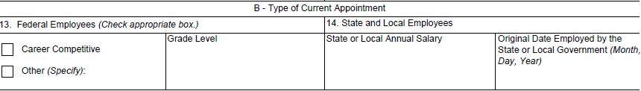
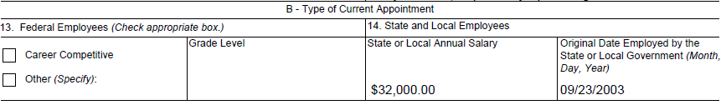
Part 4: Position Held – Type of Current Appointment
For Federal Employees coming from another agency .
LEAVE BLANK for all others.
Start Date of Employment with Current Employer. Must be 90 days prior to IPA start date.
Yearly Salary from Current Employer.
EXAMPLE

Slide 10
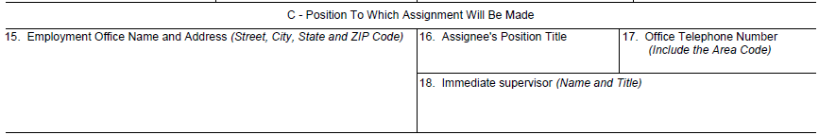
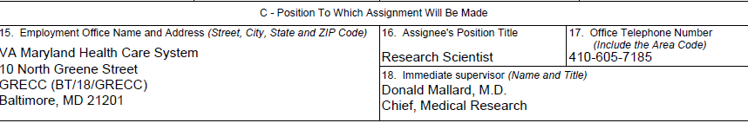
Part 4: Position Data –
Position To Which Assignment Will Be Made
This will ALWAYS be the VA Maryland Health Care System (Local VAMC) and Service to be assigned to (Research / MIRECC / GRECC / DU / MSCOE)
Current Employee Title. Examples of Hard-To-Fill Positions: Statistician, Chemist, Nurse Coordinator, Scientist.
Name and Title of IPA/Project Supervisor
VA Work Phone Number
EXAMPLE

Slide 11
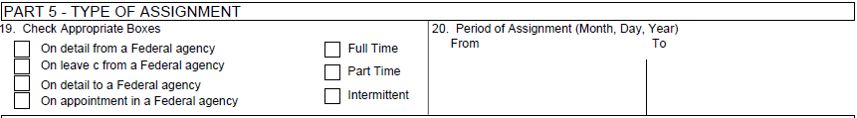
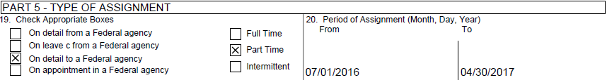
Part 5: Type of Assignment
Must check one.
Most IPA’s for VAMHCS are 3rd one – On Detail To A Federal Agency.
Must check one.
If Part-Time, please enter % effort next to the box.
Enter Start Date and End Date of IPA Agreement. Must be 90 days after #14, Part 4, Section B.
and MUST be 30 days prior to submission to HR. Cannot exceed a period of two years.
EXAMPLE
60%
Notes:
IPA cannot start any work until a completely approved packet has been sent to the requesting service by HRMS.

Slide 12
Part 6: Reason For Mobility Assignment
When completing this section, must state HOW the assignment will benefit the VA and other organization, what project the IPA will be working on, if research will be shared between organizations or published, improve veteran care, etc. Write a rationale, not description of duties. Use additional pages if necessary.
The reasons for assignment must cover one or more of the OPM Four Objectives** listed on the IPA Checklist/Worksheet:
  Strengthening the management capabilities of federal agencies, State/Local/Indian tribal governments or other eligible organizations.
  Assisting the transfer and use of new technologies and approaches to solving governmental problems.
  Facilitating an effective means of involving state and local officials in developing and implementing Federal policies and programs.
  Providing program and developmental experience which will enhance the assignee’s performance in his/her regular job.
  **If you wish to use these objectives, you must list how/why/what will be done on each objective (i.e., what will be strengthened and how, what new technologies will solve what problems, etc.). Copying the objectives is not acceptable.
You must advise how the IPA employee will be utilized at the end of the assignment (i.e., return to employer, become a federal employee, etc.)
Administrative and/or Support positions are not allowed.

Slide 13
Part 6: Reason For Mobility Assignment – UNACCEPTABLE
VAGUE AND DATES FOR IPA DO NOT MATCH:
For this position, Mr. DiNozzo's skill set and background will be used to support Dr. Mallard's VA Merit Project "A Knock at the Door" which ends 1/31/16. (Must certify IPA is approved to work on project that has ended (i.e. NCE).
VAGUE: These do not explain why the assignment is needed, how it will help the Agency, meet the OPM IPA objectives, or how employee will be utilized at end of assignment:
The employee has worked previously with Dr. Mallard on related research. Mr. DiNozzo has shown the skills necessary to carry out the work. He has been apprised as to the requirements of the experiments that Dr. Mallard will be conducting.
The purpose of the assignment is to maintain the Directoral aspects of the research program. Mr. DiNozzo's expertise will continue to provide direction and leadership to the programs.
Mr. DiNozzo has experience working in research as well as knowledge of VA and other regulatory requirements regarding to the conduct of VA research.
As a Co-Investigator of the project entitled “A Knock at the Door”, Mr. DiNozzo will devote 50%. He is a research scientist experienced in the assessment of forensic pathology.
Mr. DiNozzo will work in close collaboration with Dr. Mallard. His research, while expected to be independent, should also build on prior research conducted.
VAGUE AND NEEDS CLARIFICATION:
The employee has experience with forensic research and will fit well with the study. Mr. DiNozzo will complete specific aims associated with the project making this assignment prudent. Accordingly, this project has defined time parameters with a clear sight. (What are “specific aims”, “time parameters” and “clear sight” )

Slide 14
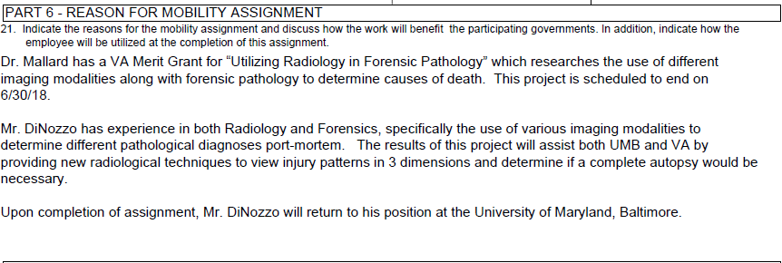
Part 6: Reason For Mobility Assignment – ACCEPTABLE
Notes:
This is just an example – you can add more detail specific to your projects and why the assignment is needed.

Slide 15
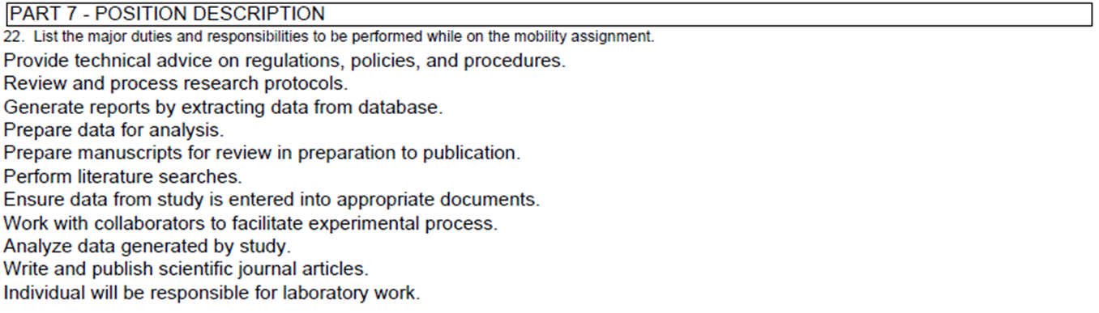
Part 7: Position Description
The position should include significant, specialized, and/or scientific responsibilities. This part should also include a scope of work that relates to the specific project that the IPA candidate will work during the assignment. Include location of work, hours of duty, and statement “Employee is responsible for hours of duty and for notification to supervisor of any inability to be present for work”. Administrative and support duties should not be listed.
EXAMPLE S – UNACCEPTABLE
(Vague and Administrative or Supportive)

Slide 16
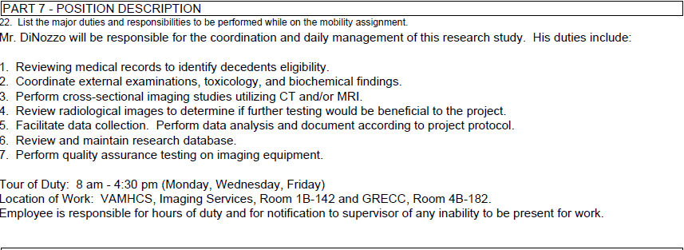
Part 7: Position Description - ACCEPTABLE
Notes:
Just an example – be as specific as you can regarding the responsibilities and actual duties the IPA will be performing.

Slide 17
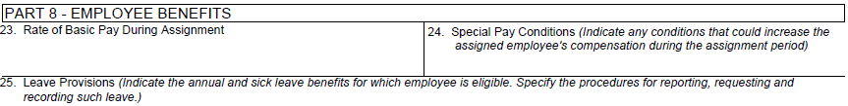
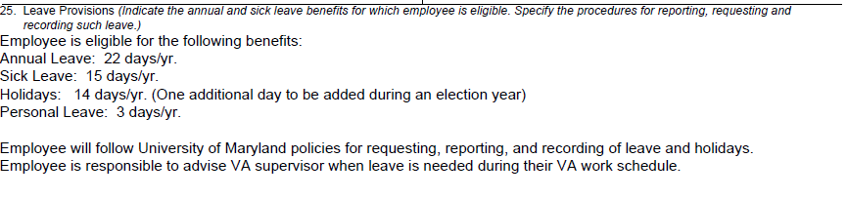
Part 8: Employee Benefits
Indicate annual, bi-weekly or hourly salary. Should be same as Page 1, #14.
Example: Cost of Living Increases, Fringe Cost Increases
Benefits entitled by current employer – i.e.
University/State/Local Government Agency or NPC (Non-Profit Research & Education Corporation).
EXAMPLE
Notes:
#24 and #25 are to cover any pay/leave that IPA gets from employer. If your project does not permit any special pay or leave, please document as “None”.

Slide 18

Part 9: Fiscal Obligations
Should be the actual financial obligations the VA will be paying out.
Name and Address of University/State/Local Government Agency or NPC (Non-Profit Research & Education Corporation) who will be submitting invoices for hours worked by IPA Employee. Also include VAMHCS Office to get invoices and VA Obligation #

Slide 19
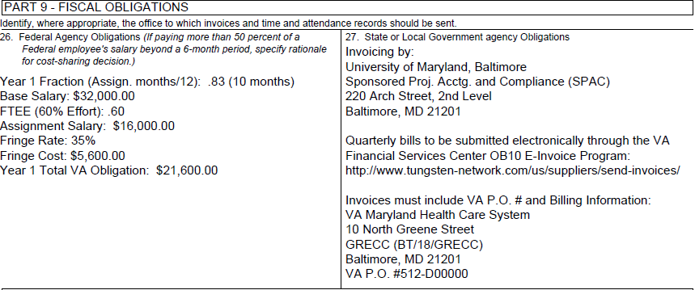
Part 9 – Fiscal Obligations
EXAMPLE
Notes:
Slide 19, can we split this into two slides?
26. This always states the specific percentage of employee’s salary
Fringe Benefits (based on actual costs) The NPC will calculate this.
25. The NPC will submit monthly (quarterly, annually) an invoice to cost center #123 (These are VA’s cost center that associate with the specific grant or project covered in this IPA)
Always include the entire mailing address.

Slide 20
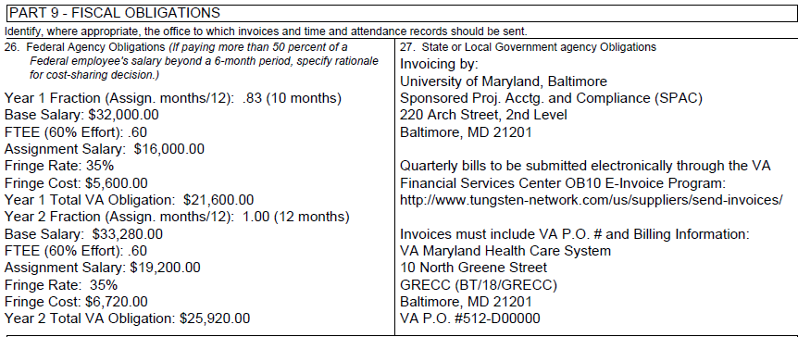
Part 9 – Fiscal Obligations
EXAMPLE – TWO YEAR IPA
Notes:
Slide 19, can we split this into two slides?
26. This always states the specific percentage of employee’s salary
Fringe Benefits (based on actual costs) The NPC will calculate this.
25. The NPC will submit monthly (quarterly, annually) an invoice to cost center #123 (These are VA’s cost center that associate with the specific grant or project covered in this IPA)
Always include the entire mailing address.

Slide 21
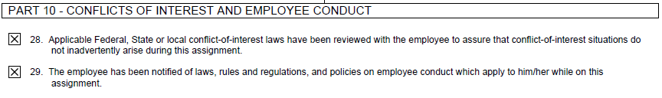
Part 10: Conflicts of Interest and Employee Conduct
Both must be checked certifying that the Supervisor has reviewed required COI and conduct rules/regulations with proposed IPA Employee. (VHA Handbook 1660.03, Conflict of Interest Aspects of Contracting for Scarce Medical Specialist Services, Enhanced Use Leases, Health Care Resource Sharing, Fee Basis, and Intergovernmental Personnel Act Agreements (IPAS).

Slide 22
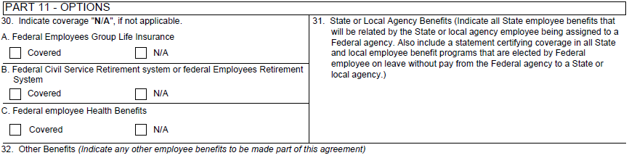
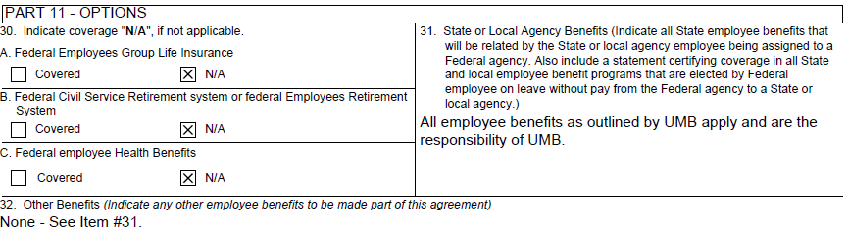
Part 11: Options
IPA’s do not receive federal benefits.
Indicate current employer maintains all benefits.
EXAMPLE

Slide 23

Part 12: Travel & Transportation Expenses and Allowances
Must indicate if Service plans to allow IPA to travel, including reasons for travel, costs, and dates. Otherwise, no travel is allowed. Please note that if travel is allowed and the IPA agreement is terminated early (equaling less than one year), the IPA is liable to the VA for all travel expenses incurred.
EXAMPLE

Slide 24
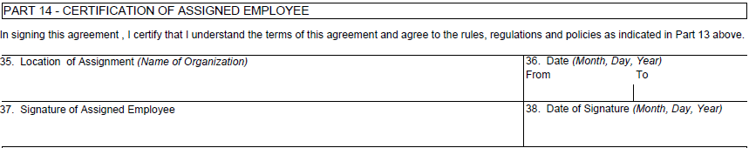
Part 14: Certification of Assigned Employee
Should match Page 1, Section C - #15 – Employment Office Name & Address
Must match Page 2, Part 5, #20 – Period of Assignment
Original signature and date of proposed IPA Employee

Slide 25
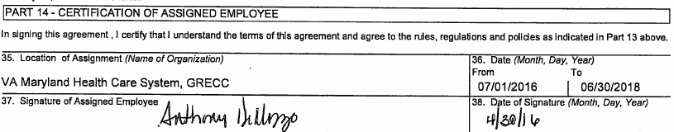
Part 14: Certification of Assigned Employee
EXAMPLE

Slide 26
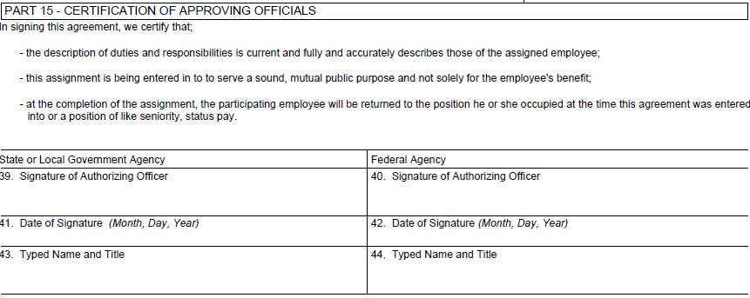
Part 15: Certification of Approving Officials
Signature of University/State/Local Government Agency or NPC (Non-Profit Research & Education Corporation) Approving Official
NEW IPA - Signature of VAMC Chief of Staff
EXTENSION/MODIFICATION – Signature of VAMC Director
(HRMS WILL OBTAIN SIGNATURE)
Must be dated prior to IPA start date. IPA can’t start until a signed agreement is in place.

Slide 27
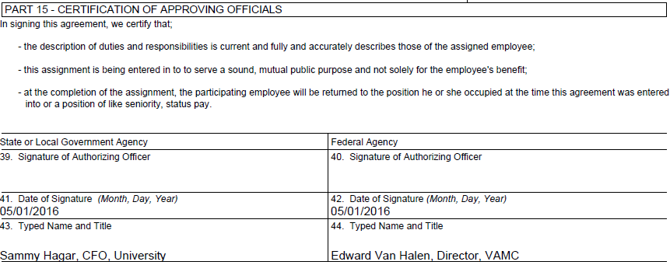


Part 15: Certification of Approving Officials
EXAMPLE

Slide 28
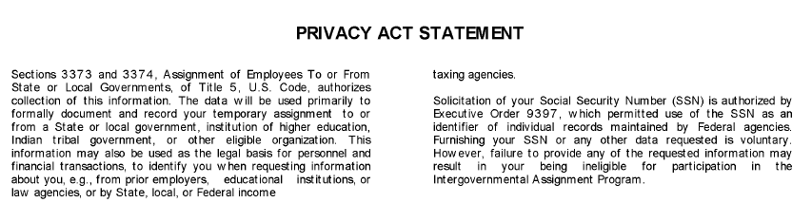
Privacy Act Statement

